Slide 1
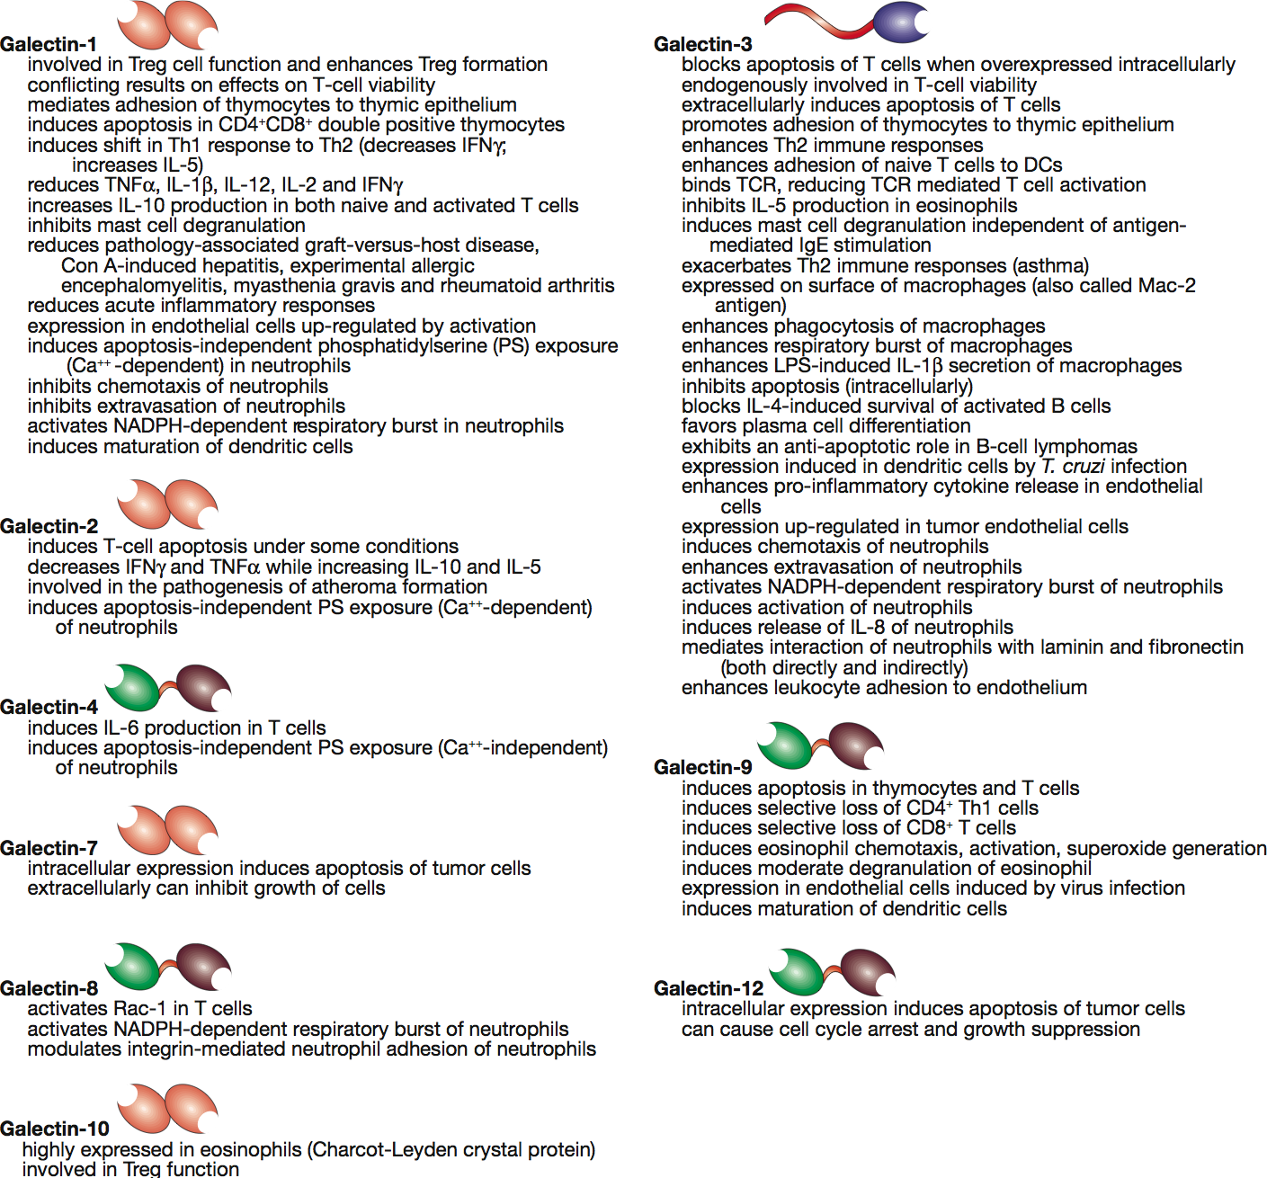


Functions of galectins and biological activities in the immune system
Essentials of Glycobiology
Chapter 33, Figure 5
Second Edition
Notes:
FIGURE 33.5. A list of known and putative functions and biological activities of galectins toward cells in the immune system.

